Slide 1
Datathon – Team 8
Project Overview
Oreayo Israel-Bolarinwa
Malik Alam
Notes:
Cover Accenture solid

Slide 2


Agenda
1
2
3
4
Data Extraction, Cleaning and EDA
Loading Cleaned Data into SQL Database
Data Modelling Using SQL Queries, Importing Data Model
Visualising Data Using Power BI
Notes:
Agenda pictures

Slide 3
Problem Statement
Task
Diabetes is a complex, chronic endocrine disorder, affecting millions of British people per year. November is Diabetes Awareness month, and your client - a drug manufacturer, have just secured funding to break ground in the critical disease segment: Diabetes. So, in preparation to launch the novel product, and in honour of Diabetes awareness month (November), and they want you to analyse the impact of the disease on the human body.
They have hired you, a team of Data Enthusiasts, to spend two weeks performing data analysis and visualisation, to inform their approach.
Deliverables
• A detailed report outlining the data cleaning and preprocessing steps taken, with justifications for each decision.
• An initial EDA report that includes key insights and visualizations (e.g., histograms, scatter plots, heatmaps) generated using Python libraries like Matplotlib or Seaborn.
• A clean, well-prepared dataset stored as a new CSV file or as Data frame.
• A brief report explaining schema design with implemented SQLs.
• A visualisation report that translates the data analysis into actionable insights for stakeholders.
Notes:
Two Key Points Comparison Text

Slide 4
Data Extraction, Cleaning and EDA
1.
Data Profiling – looked at type, data quality and distribution of all data columns in the original dataset.
2.
Treatment of Missing Values – Applied several techniques to deal with missing values where appropriate.
3.
Adjusting/Removing Columns – calculation of adjusted values of old columns to more accurately represent the population. Removal of irrelevant columns.
Tasks Completed
Tasks Completed
Tasks Completed
Looked at number of null values in each column (high missingness - approx. 20% missing values for each column).
Looked at general distribution of each column using bar charts.
Looked at odd values/contaminated data (e.g. weight having a mixture of kg and pounds).
Removed all rows with a missing value for diabetes (our target variable).
Replaced nulls with median for skewed continuous variables (e.g. BMI, Age), mode for categorical columns.
Replaced nulls with mean for uniformly distributed numerical columns (e.g. diabetes_pedigree_function).
Replaced nulls with ‘unknown’ for uniformly distributed categorical columns.
Reversed engineered BMI (kg/m^2 = BMI) to create a predicted height for each observation, converting to kg if the height was deemed to be unrealistic.
Using capping/flooring to deal with outliers for continuous variables.
Grouped ages into categorical columns instead of continuous variable (e.g. 18-34).
Removed columns irrelevant to diabetes prediction (e.g. star signs).
Notes:
Three Key Points Comparison Text Line Connection

Slide 5
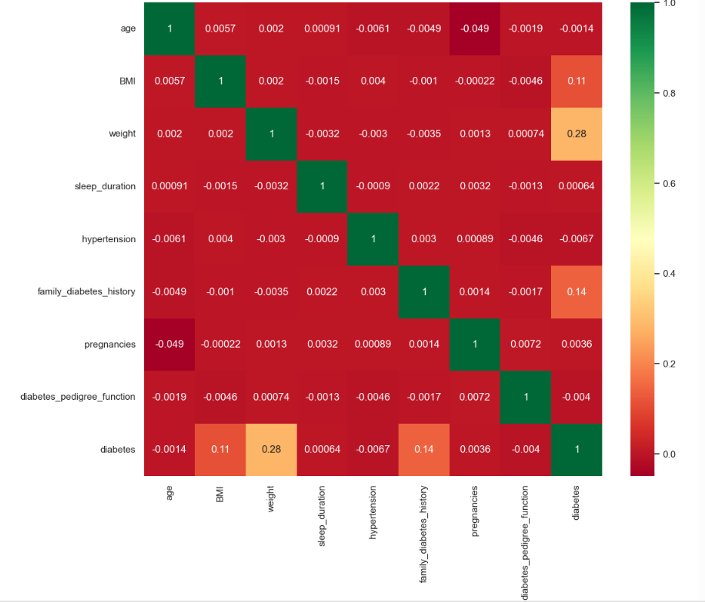
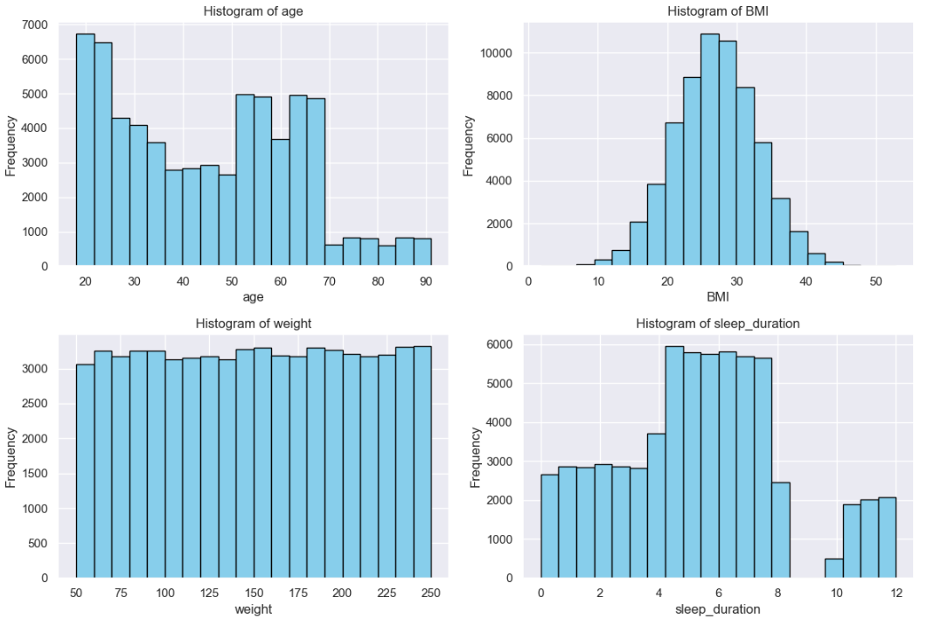
Data Extraction, Cleaning and EDA (Cont.)

Slide 6
Loading Cleaned Data into SQL Database
01
02
03
Created Empty Database
Using DB Browser, we created an empty database that our clean data would be housed in.
Imported Cleaned Data
Read cleaned diabetes data ingested from git hub as a dataframe (read_csv from pandas).
Saved Data into Database
Connected the created database to jupyter notebook (using sqlite3 library) and saved dataframe to the database.
Notes:
Three Key Points Comparison Text Bubbles Line

Slide 7
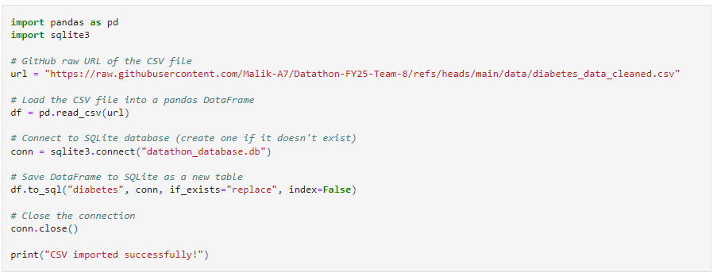
Loading Cleaned Data into SQL Database (Cont.)

Slide 8
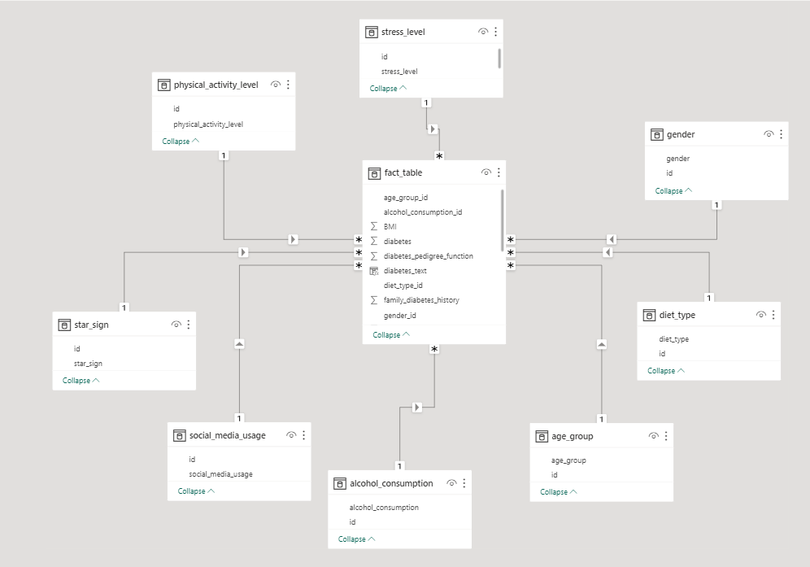
Data Modelling Using SQL Queries
The following tasks were completed using the SQL database.
Investigative queries to further understand the diabetes population.
Data Modelled using a Star Schema approach.
Creation of dimension tables for categorical columns (age group, diet type, alcohol consumption etc.) and corresponding ids for each unique value.
Creation of a fact table containing normalised values for categorical columns in addition to continuous variables.
Connection of the final database to a Power BI (Get Data) using an ODBC driver.
One to many relationships created between dimension tables and fact table.
Data model in Power BI after being imported from the DB Browser database.
Notes:
Two Key Points Comparison Text

Slide 9
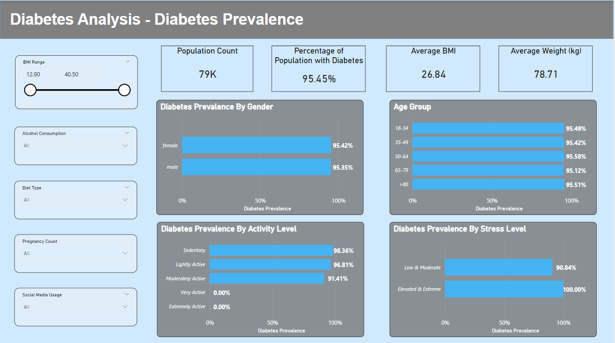
Visualising Data Using Power BI – Diabetes Prevalence
Used bar charts to display comparison of diabetes prevalence (% of individuals with diabetes – calculated via DAX) by different categories (Activity Level, Stress Level, Gender, Age Group).
Findings:
No noticeable difference in diabetes prevalence by age group & and Gender.
Increased activity level reduces the likelihood of having diabetes.
Individuals with Elevated & Extreme levels of stress were more likely to have diabetes.

Slide 10
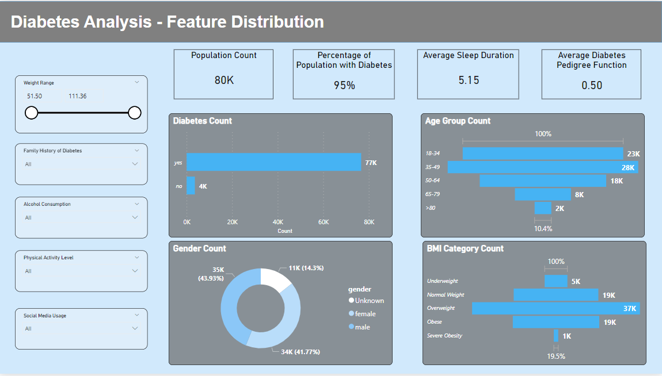
Visualising Data Using Power BI – Feature Distribution
Used this page to show distribution of columns in the dataset.
Findings:
95% of the dataset population have diabetes. This is most likely a biased dataset so not too many conclusions can be taken from analysis of the data (Around 6.5% of the UK population have diabetes).
BMI was group into categories using a calculated column. Most individuals are overweight (BMI > 25).

Slide 11
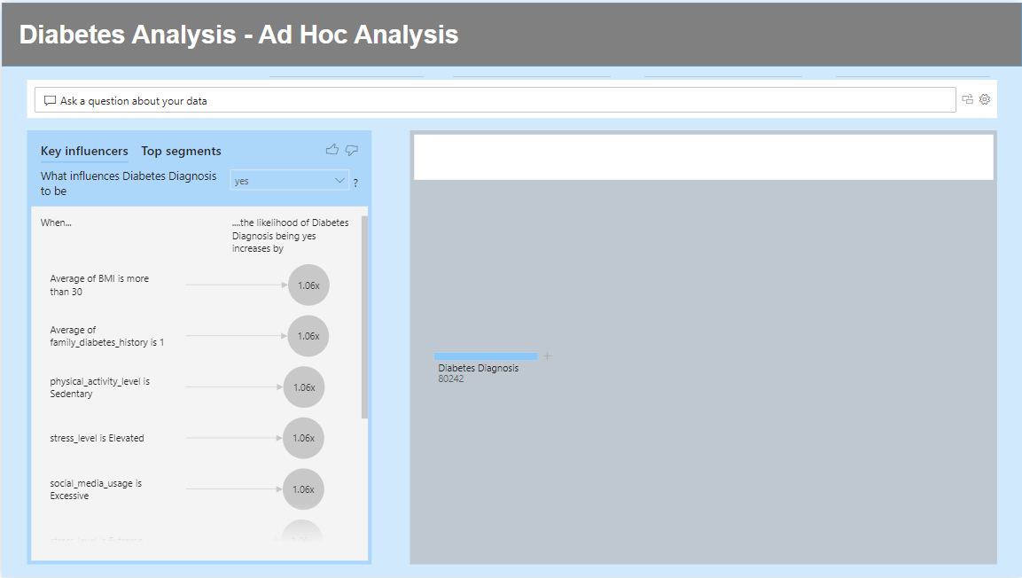
Visualising Data Using Power BI – Ad Hoc Analysis
Added Q&A, Key Influencers and Decomposition visualisations to allow individuals to conduct their own analysis.
Using Key Influencers we found the following were the biggest causes of diabetes:
High BMI/Weight (BMI over 30 > +6%)
High levels of stress (elevated & extreme > +6%)
Low level of physical activity (sedentary > +6%)
High levels of social media use (excessive > + 6%)
High levels of alcohol consumption (heavy > +5%)

Slide 12
Conclusions
Based on our findings, we would advise focusing on the following to reduce diabetes prevalence:
High levels of Exercise (at least moderately active – reduces diabetes prevalence by 2 times. 26 times for very active individuals).
Reduce Stress Levels (2.67 times less likely to have diabetes with low stress levels).
Reduce Social Media Use.
Look to reduce weight and in turn BMI.
Reduce Alcohol Consumption More Emphasis needs to be made on the above points to individuals with a family history of diabetes.
Although we’ve been able to produce actionable insights, the data isn’t perfect. The following should be considered:
Data is most likely heavily biased. 95% of the dataset population have diabetes. This is most likely a biased dataset so not too many conclusions can be taken from analysis of the data (Around 6.5% of the UK & 10% of the global population have diabetes).
Data may be subject to recall bias if not fully observed by data collectors. Users may self-report about past information or experiences incorrectly.
Difficult to measure the causal influence of the independent variables on diabetes classification e.g. are stress and diabetes just correlated or does stress directly cause diabetes. Difficult to determine with just cross-sectional data.

Slide 13
Thank You

